Slide 1
Presentation on Bangladeshi Tea Worker
Presented by
Abdullah Haris Pasha
SOM Batch 2, Roll: 18

Slide 2
The tea industry in Bangladesh has a rich history, dating back to the British colonial era when tea plantations were first established.
Today, Bangladesh is one of the top tea-producing countries, with its tea gardens mainly located in the northeastern regions of Sylhet, Habiganj, and Moulvibazar.
The industry encompasses a variety of tea types, including black, green, and specialty teas, known for their distinctive flavors and high quality.
Over the years, Bangladesh has modernized its tea cultivation and processing techniques, enhancing both productivity and the international appeal of its teas.

Slide 3
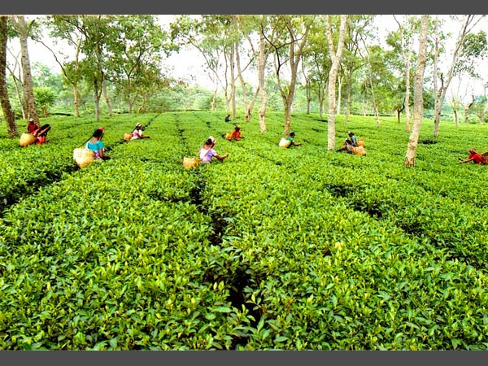

Slide 4
Importance of Tea to the Economy Tea plays a vital role in the Bangladeshi economy in several ways Employment: The tea industry employs a significant number of people, providing livelihoods for hundreds of thousands of workers, many of whom are women. these workers are integral to the industry's operations, from plucking tea leaves to processing and packaging. Export Revenue: Tea is one of Bangladesh's major export commodities. the revenue generated from tea exports contributes substantially to the national economy, supporting economic growth and development. Rural Development: The presence of tea plantations in rural areas helps in the development of infrastructure, education, and healthcare facilities. the industry's investments in these regions contribute to overall community welfare. Cultural Significance: Tea is an important part of Bangladeshi culture and daily life. it fosters social interactions and hospitality, making it an integral part of the country's cultural heritage.

Slide 5
Challenges Faced by Tea Workers Low wages and long working hours health and safety concerns limited access to education and healthcare

Slide 6
Ongoing Initiatives to Improve Working and Living Conditions Programs aimed at enhancing health and safety standards in tea plantations. Educational initiatives for tea workers' children to break the cycle of poverty. Infrastructure development projects to provide better housing, sanitation, and access to clean water.

Slide 7
The Role of Fair Trade and Ethical Consumerism
Promoting fair trade certifications to ensure fair wages and working conditions for tea workers.
Encouraging consumers to support brands that adhere to ethical production practices.
Highlighting the impact of ethical consumerism on improving the lives of tea workers and their communities.

Slide 8
THANK YOU

